Slide 1
Garbage in, garbage out?
Measuring error rates and data quality to get ready for AI
#SDinGOV
Caroline Jarrett
@cjforms.bsky.social

Slide 2
Welcome and please ask
This workshop is being recorded
Please join in with your questions and comments
Slides are Creative Commons licensed
  Email cj@effortmark.co.uk to get a copy or
  Look on SDinGOV Slack or
  Pop along to my website in a few days: effortmark.co.uk
You’re welcome to use the slides as you wish provided you credit me or whoever I’ve credited on the slides

Slide 3
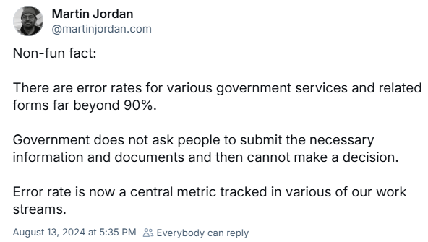
Martin Jordan announced error rate as a metric
https://bsky.app/profile/martinjordan.com/post/3kzmgtkdcuz2k

Slide 4
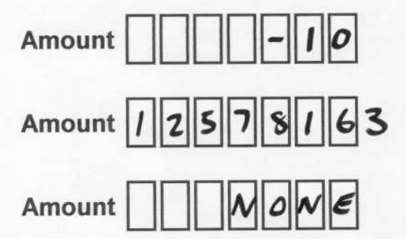
I got interested in better forms because of errors
Understanding the costs of data capture: paper, automatic and with the internet - Effortmark

Slide 5
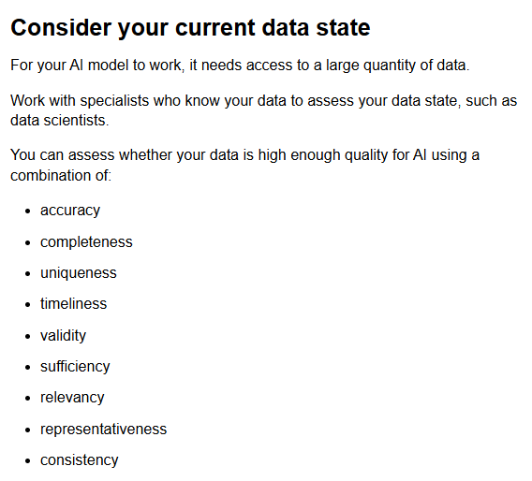
For “AI”, data quality matters
Assessing if artificial intelligence is the right solution | Centre for Digital Public Services

Slide 6
Agenda
Think about fudging forms
Consider errors in the services we work on
Try using “Six ways to think about errors”
Focus on error rates
Meet the data quality framework
Think about what we might do differently

Slide 7
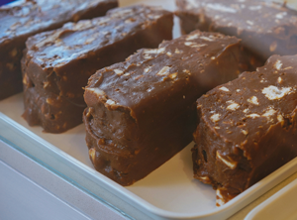
I’ve observed that people “fudge” through forms
To fudge a form:
answer one or more questions
in a way that’s not entirely truthful
Photo by Phil Hearing on Unsplash
FUDGE | definition in the Cambridge Learner’s Dictionary

Slide 8
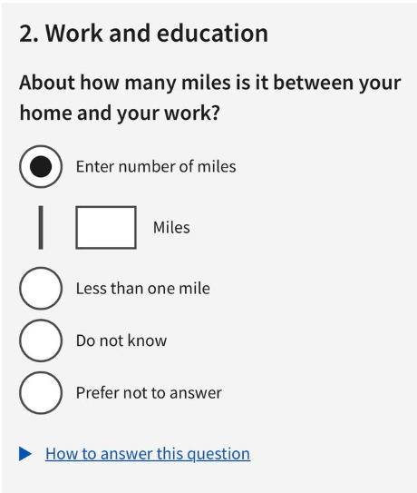
Let’s try this question
Image credit: Simon Morgan-Wilson from a UK government service

Slide 9


Share an example
I had to give a wrong answer to that question.
If you’ve ever given an inaccurate answer on another question, please tell me about it in this EasyRetro.
bit.ly/gigo25
3 minutes

Slide 10
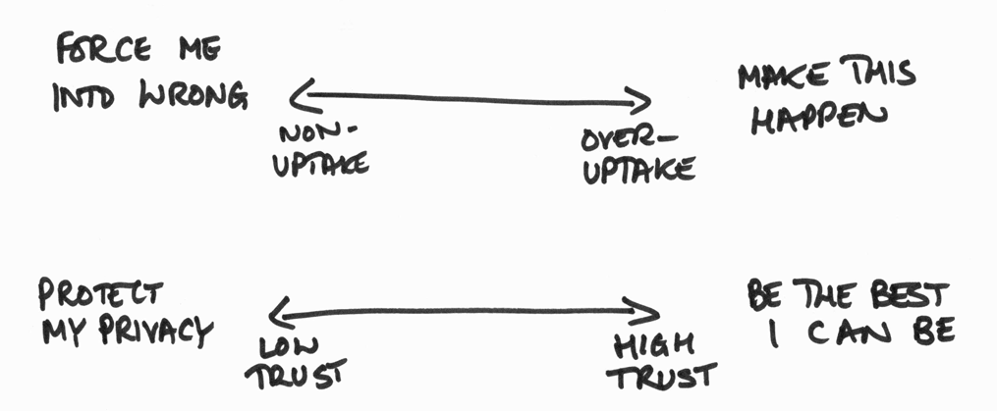
I’m thinking about why questions get wrong answers

Slide 11
Takeaway
There are many ways in which the data we collect isn’t entirely accurate

Slide 12
Agenda
Think about fudging forms
Consider errors in the services we work on
Try using “Six ways to think about errors”
Focus on error rates
Meet the data quality framework
Think about what we might do differently

Slide 13
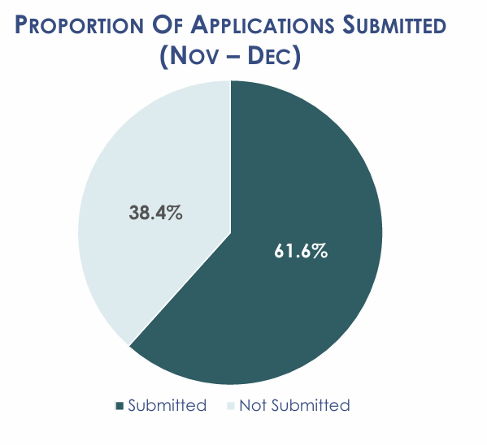
Some people don’t get to the end of their application
People on low incomes or no income in California can apply for government money to buy fresh food (CalFresh).
https://www.calsaws.org/wp-content/uploads/2025/02/BenefitsCal-Usage-Metrics-Report-Nov-Dec-2024.pdf

Slide 14

The result matters more than the journey
People rarely fill in forms for fun
We’re aiming to achieve some result
Photo by Marcos Ramírez on Unsplash

Slide 15
Let's learn from our experiences with errors
Add a card to the EasyRetro
    a brief description of a service that
    your team is working on
    an example of something that
    you consider is an error in that service
  Please write one card for each error
  bit.ly/gigo25
  3 minutes

Slide 16
Agenda
Think about fudging forms
Consider errors in the services we work on
Try using “Six ways to think about errors”
Focus on error rates
Meet the data quality framework
Think about what we might do differently

Slide 17
Here are some ways to think about errors
Thanks to the team at HMRC who inspired this
Errors | Examples
Problems along the way | Tried to buy 2Kg carrots, ordered 2 carrots
Wrong result | Ordered pork pie, got lettuce
Unnecessary action | No delivery arrives, called to find out why
Delayed-impact problem | Credit card OK when placed order, failed later
Non-uptake | Decide to use a different supermarket
Over-uptake | Accidentally placed order twice
Technology issue | Supermarket goes offline due to cyber-attack
Something else | ?
How to think about errors in services - Effortmark

Slide 18
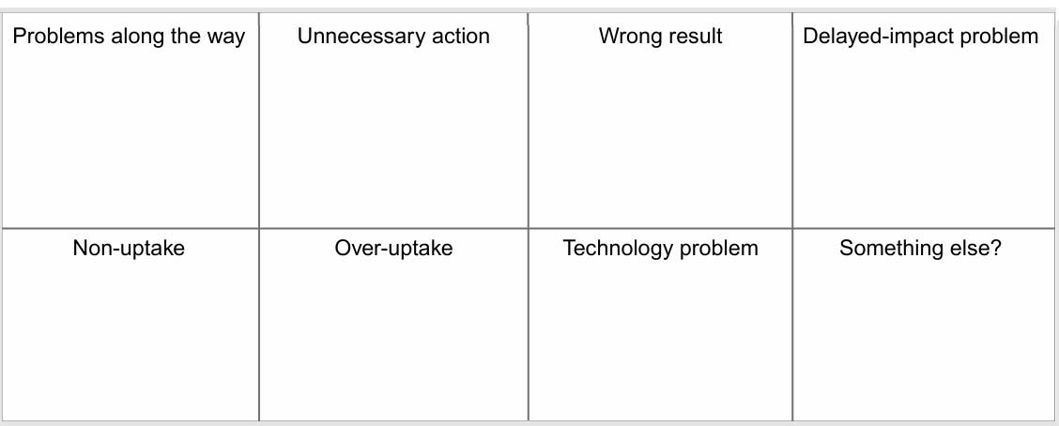
There’s a template you can use
https://www.effortmark.co.uk/wp-content/uploads/2025/10/Error-categories-chart.pdf

Slide 19
Do your errors fall into these categories?
Add a note to your card(s) to say what category of error
  2 minutes
bit.ly/gigo25

Slide 20
Agenda
Think about fudging forms
Consider errors in the services we work on
Try using “Six ways to think about errors”
Focus on error rates
Meet the data quality framework
Think about what we might do differently

Slide 21
And now, what about error rates?
If you know the error rate for any of the errors in your service, please move the card to the 3rd column
Or add a fresh card to that column
2 minutes
Notes:
Give out/uncover posters and explain

Slide 22

Only about a third of errors had a known error rate
Image credit: Caroline Jarrett

Slide 23
Completion rate is a relatively simple calculation
(also known as conversion rate)
Number of people who complete
Completion rate =
Number of people who start

Slide 24
Error rate might also be simple
Number of errors
Error rate =
Number of people who start

Slide 25
Other error rate calculations are available
Number of attempts with an error
Error rate =
Number of people who start
complete
are eligible
other?

Slide 26
Example: there are at least 3 definitions of turnout In an election, a failure to vote is an error
Number of votes counted
Turnout =
Number of people who
Send in postal votes or go in person
Are on the electoral roll
Are in the voting-eligible population
Thanks to Whitney Quesenbery for this example

Slide 27
Takeaway
To track your error rates:
Count the errors
Think hard about
what you divide by

Slide 28
Agenda
Think about fudging forms
Consider errors in the services we work on
Try using “Six ways to think about errors”
Focus on error rates
Meet the data quality framework
Think about what we might do differently

Slide 29

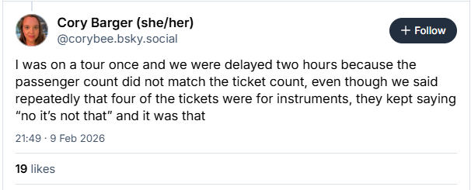
Data in use can conflict with data as collected

Slide 30
Previous
takeaway
There are many ways in which the data we collect isn’t entirely accurate

Slide 31
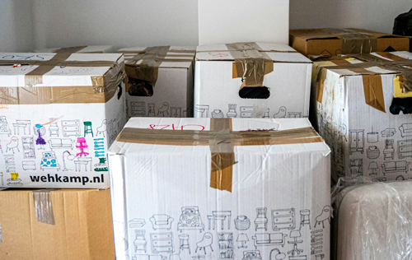
Data quality can deteriorate or change all by itself
People change
  Lose their credit card
  Move house
  Change jobs
  And many others
Organisations change
  Delete an old product
  Add a new one
  Are affected by energy costs
  And many others
Photo by Michal Balog on Unsplash

Slide 32

Missing data can have serious effects
The Home Office destroyed the documents that migrants later needed to prove their right to remain
'Windrush' migrants facing deportation threat - BBC News

Slide 33
Previous
takeaway
There are many ways in which the data we collect isn’t entirely accurate

Slide 34
New
takeaway
There are many ways in which the data we use isn’t
entirely accurate

Slide 35
What about long-term data quality?
Are there data quality issues that might arise over time?
Add a card for any issue that you think of
3 minutes

Slide 36

There is a UK Government Data Quality Framework
The Government Data Quality Framework - GOV.UK

Slide 37
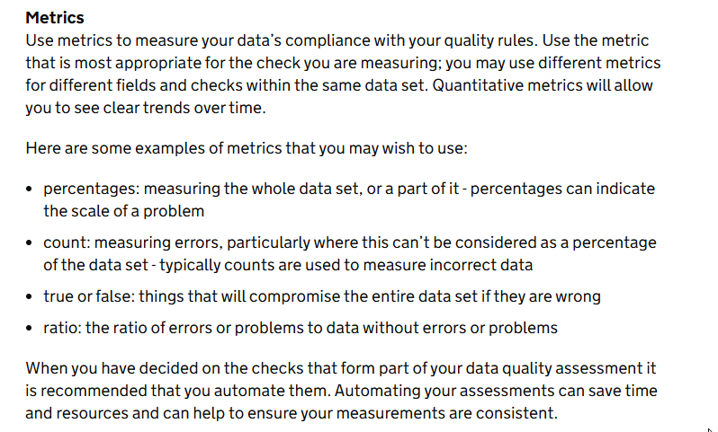
For example,
“data quality plans” include error rates
https://www.gov.uk/government/publications/the-government-data-quality-framework/the-government-data-quality-framework-guidance

Slide 38
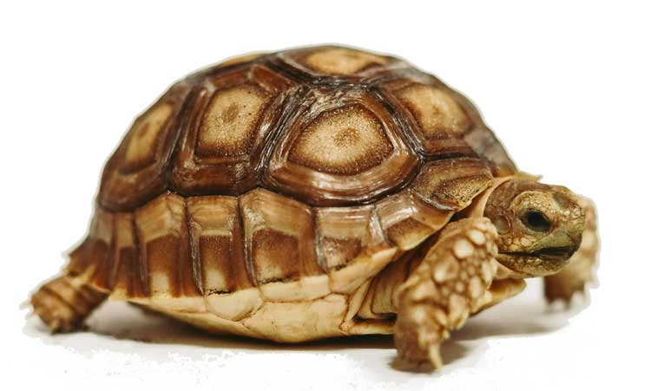
My favourite is the tortoise
“ For each check, decide what fit for purpose looks like. These are not rules that every value must meet, but they should describe what typical good quality looks like.
For example, an animal’s date of birth will typically be within the last 50 years, but the data set would not suddenly become unfit for purpose if a tortoise born in 1900 was entered. We might set this value at a target of 98%.”
https://www.gov.uk/government/publications/the-government-data-quality-framework/the-government-data-quality-framework-guidance
Image credit: Photo by Craig Pattenaude on Unsplash

Slide 39
For “AI”, data quality matters
Assessing if artificial intelligence is the right solution | Centre for Digital Public Services

Slide 40
Takeaway
Data quality is important but not easy

Slide 41
Agenda
Think about fudging forms
Consider errors in the services we work on
Try using “Six ways to think about errors”
Focus on error rates
Meet the data quality framework
Think about what we might do differently

Slide 42
Add ideas for doing something
There’s a column for anything that you might decide to do or to do differently
bit.ly/gigo25
5 minutes

Slide 43
Takeaway
AI may help to start useful conversations about error rates and data quality

Slide 44
I’m starting to collect some resources
General advice on measurement
Steve Messer Metrics, measures and indicators: a few things to bear in mind
Official / government guidance
ONS Quality in official statistics - Office for National Statistics
Headline stories
The Guardian Windrush victims could have compensation reconsidered
Disability News DWP helped cause mental distress of claimant who took her own life
Academic research
The King’s Fund Lost In The System: The Need For Better NHS Admin

Slide 45



Keep up the conversation: Caroline Jarrett
BlueSky @cjforms.bsky.social
cj@effortmark.co.uk
www.effortmark.co.uk

