Slide 1
Service patterns: how to identify, document, and implement
SDinGov Virtual 2026
11th March 2026

Slide 2



We are…
Martin Ford-Downes
Ministry of Justice
(UK Government)
Lindsay Stephens
Department for Work and Pensions
(UK Government)
Gareth Thomas
Department for Environment, Food & Rural Affairs
(UK Government)

Slide 3
Outline of session
What are service patterns?
Introduction to our service pattern library
Activity: build a service pattern journey
Reflection & feedback
Resources
Q&A

Slide 4
Session outcomes
Describe what service patterns are, and their uses
Create a user journey using service patterns
Discuss ideas for next steps
Access service pattern resources

Slide 5
What are service patterns?
Service patterns are replicable pieces of services that can be combined to build or shape end-to-end services.
End to end service
Service patterns

Slide 6
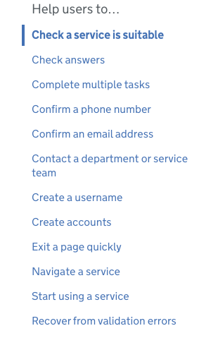
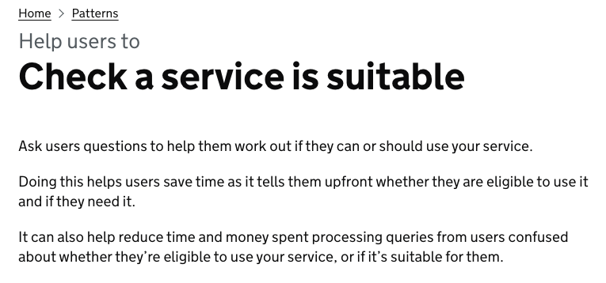
Examples of services
Notes:
Some of these digital patterns get a bit more complex, involving multiple pages, like this one for checking whether a service is suitable for you.

Slide 7
…can we define patterns for more complex tasks?
Notes:
From there it is reasonable to ask – can we define patterns for more complex tasks?

Slide 8
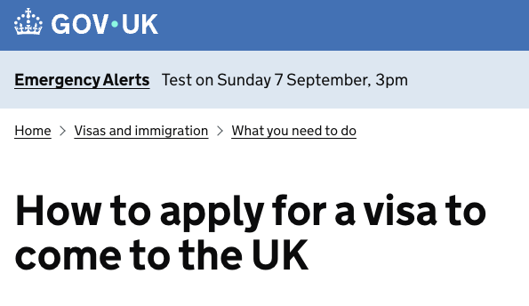
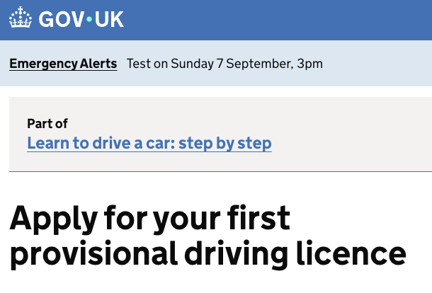
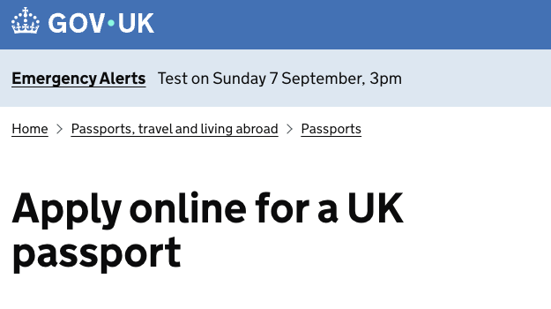
Examples of services to apply for things

Slide 9
UI components and patterns vs service patterns
UI Components / Patterns
Service Patterns
UI Components / Patterns
UI Components / Patterns
Specific actions and tasks
Digital focus
More specific
End-to-end user tasks
Multi-channel
Less specific
Notes:
Components in design systems focus on digital interactions for relatively specific user actions. The patterns we find there get more complex than that and go as far as describing some complete digital tasks, but they are still tightly scoped and do not normally describe the complete journey a user would go on to complete their goal.
Service patterns look at entire tasks, like applying for something. They’re multi-channel, considering steps beyond the computer screen. Their scope is broader, so they’re likely to be less specific, and that’s because they need to work across many contexts. Whilst many parts of the service can be standardised, bigger patterns will likely mean more complexity and variations, to cater for the differences between various services.
Applying to be a foster parent is probably going to be more complex than applying for a parking permit. Or maybe I should say it should be more complex — I wouldn’t be surprised if applying for parking permits isn’t as simple as it should be, but you get my point.
Service patterns, because of their scope, have to sit at a medium level of zoom. Not so low that they are too restrictive, but not so high that they don’t provide value. Just the content that we are most confident is common and shared across all services of a certain type.
There is still a debate to be had about how I’ve split things here. It might be that service patterns are more useful with a greater focus on digital screens and flows. We don’t yet know which version will prove more useful.

Slide 10
Service patterns can map user journeys
A (very) simple service pattern journey to notify a service that your phone number has changed:
Find
Confirm
Tell
Find the service to update your phone number
Tell the service your new telephone number
Confirm your new telephone number before submitting

Slide 11
Real journeys can be complicated
Does your specific service require additional user steps?
Authenticate
Give permission
Provide evidence
Does your service require the user to login?
Does your service require proof of the new number?
Do you need to ask for permission to use the number for certain purposes?

Slide 12
Service patterns for specific user scenarios
Like journey maps, service patterns can be used to map specific user scenarios. A complete service is likely to have other scenarios to cater for.
Find
Confirm
Tell
Authenticate
Provide evidence
Give permission
What if the user has forgotten their username?
What if the user types in the wrong new telephone number?
What if the user abandons the journey?

Slide 13
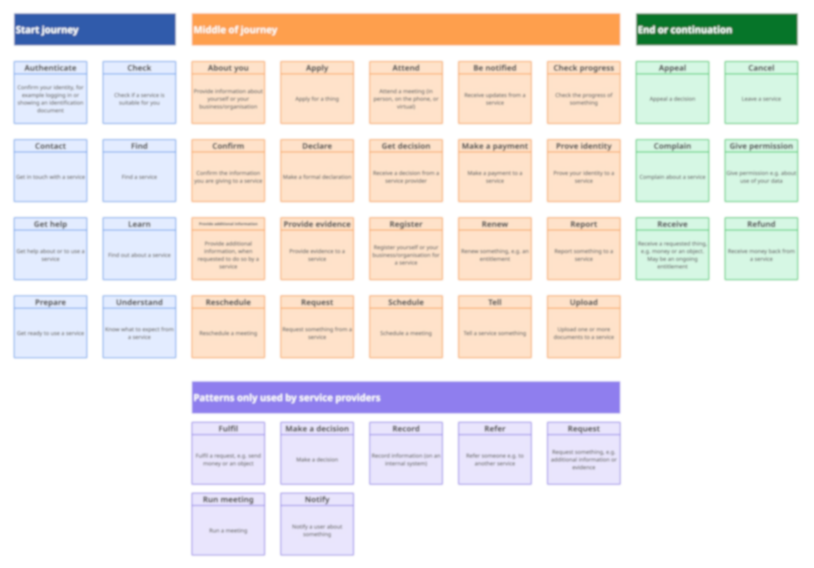
Moving to a new service pattern menu
Record
Book
Evaluate
Decide
Pay
Inform
Understand
Request
Apply

Slide 14
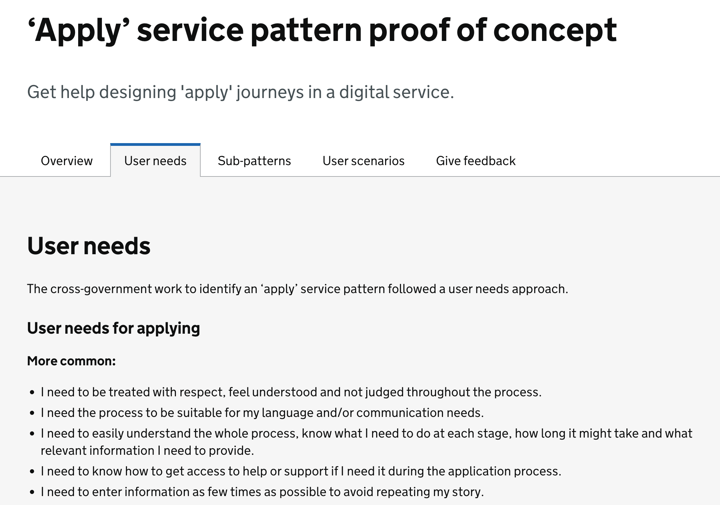
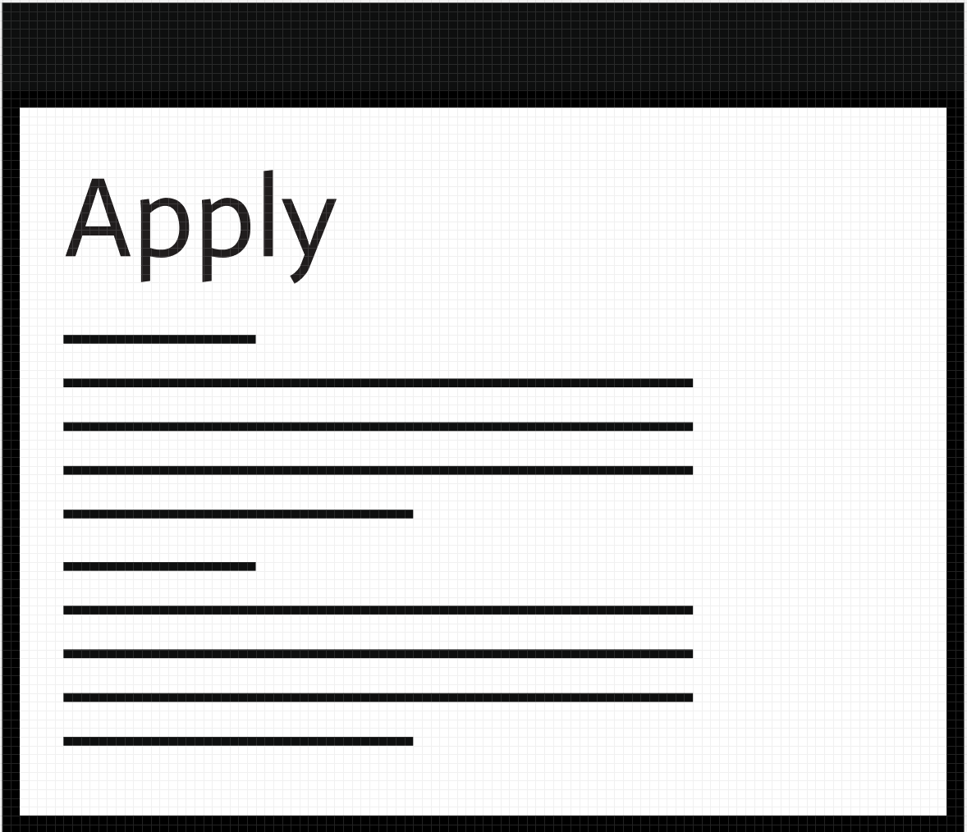
We think a library of service patterns would act as design guides to build services in repeatable and consistent ways.

Slide 15
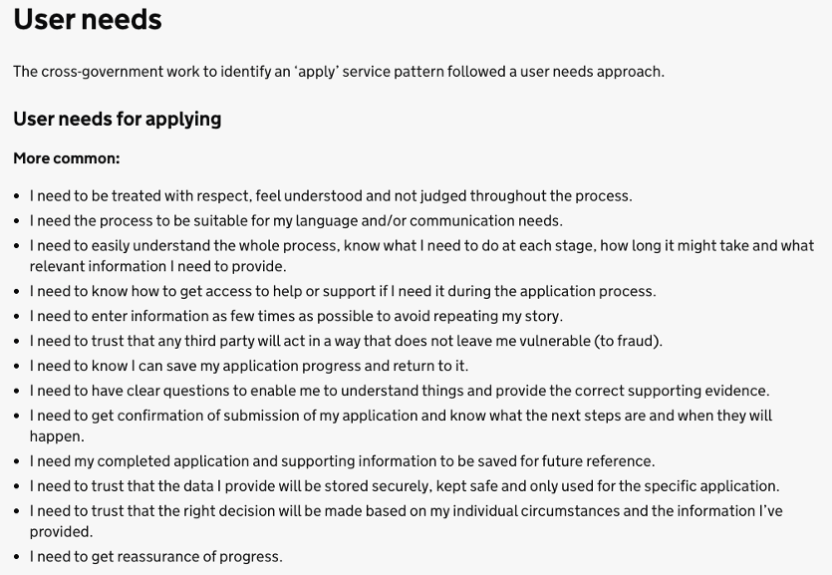
The library will contain:
User needs
Scenarios
Case studies
Guidance
Screen suggestions
Component suggestions

Slide 16
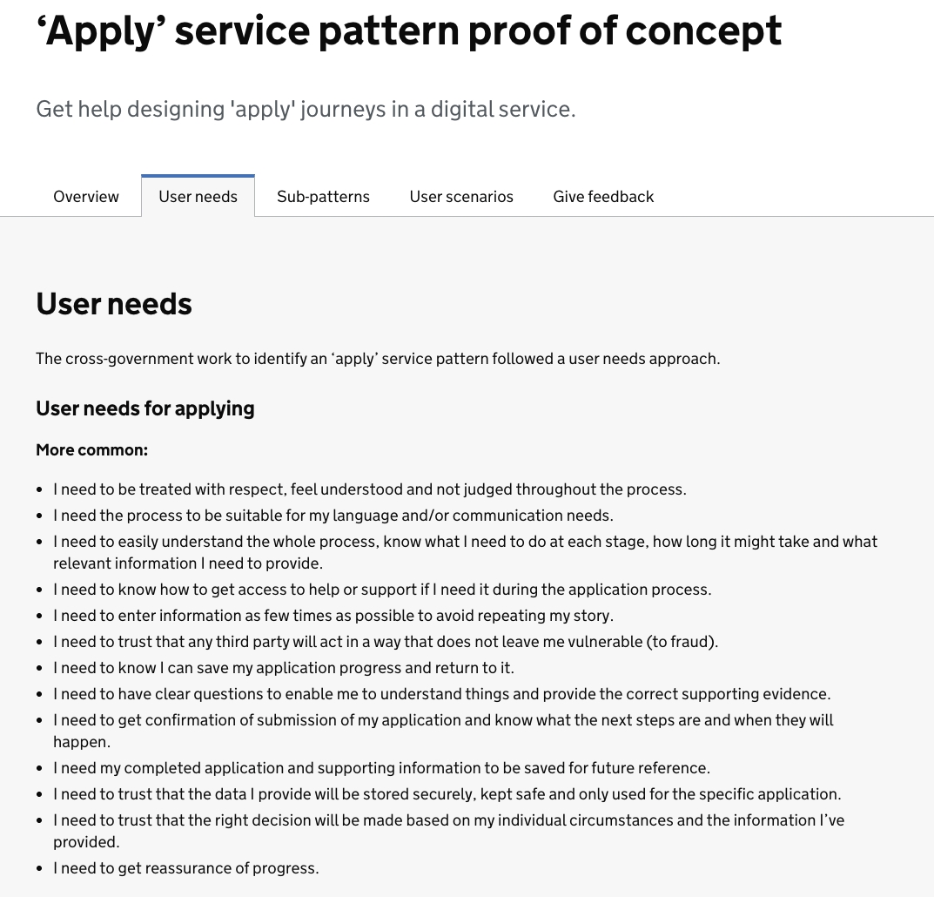
Apply service pattern proof of concept
Notes:
For user needs we looked at both the needs of the person applying, and the person managing the application. We labelled some as “more common” based on the number of contributors that agreed it would apply to their department, and some as “less common” where fewer departments agreed to it. Nothing in the service pattern is absolutely mandatory however – it’s our expectation that designers would still need to validate which parts are suitable for the service they are designing.

Slide 17
Service pattern menu + content library

Slide 18
Benefits:
easily get started designing new services
avoid repeating research
organise and understand the services you offer
a framework for planning new services
a guide to reusable assets and components
consistent user experiences across multiple services

Slide 19
Service patterns do not replace the need for research and design

Slide 20
Today’s session will focus on mapping journeys with service patterns

Slide 21
You can use this method to:
Map your existing services to spot opportunities for alignment, reuse and rationalisation.
As part of collaborative design, especially with non-designers, create as-is or to-be maps.
Identify potentially unconsidered user needs, to be explored and validated.

Slide 22
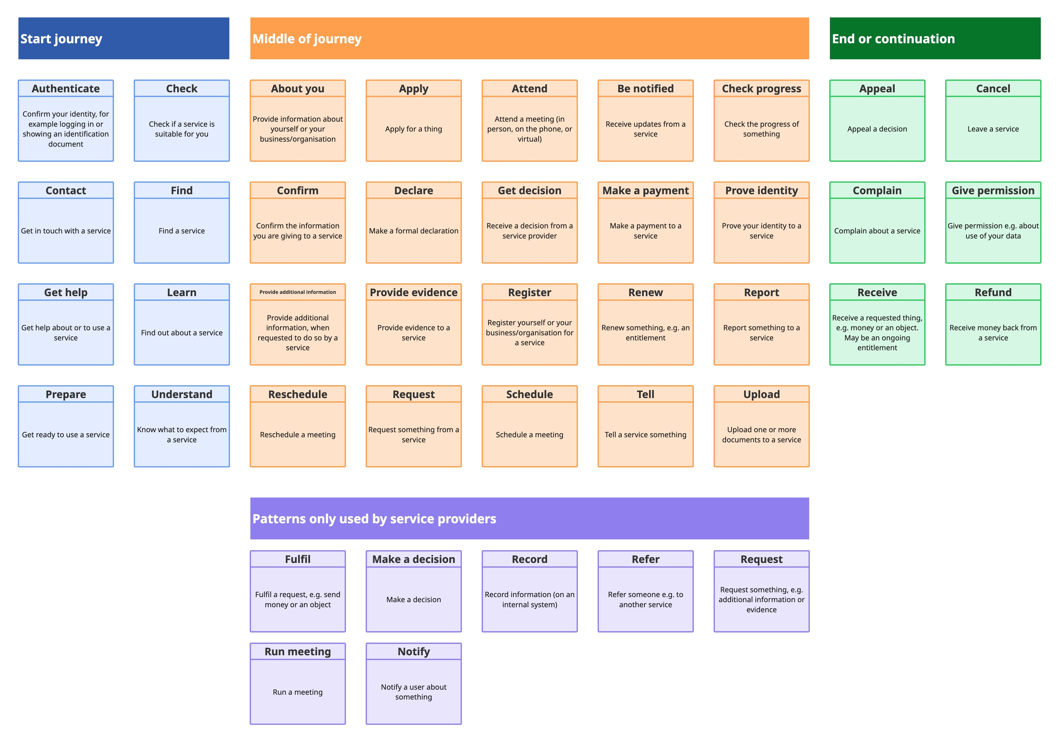
The service pattern menu
Notes:
Squares are service patterns
Presented in a menu you can choose from
Categorised where they might appear in the journey

Slide 23
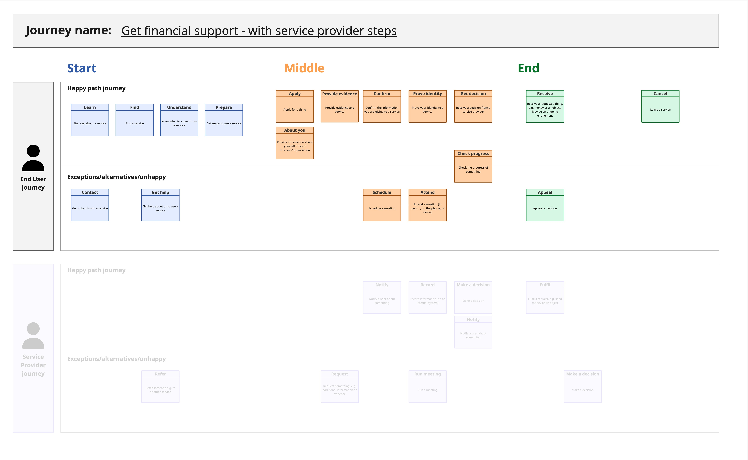
End User journey example
Notes:
Squares are service patterns
Presented in a menu you can choose from
Categorised where they might appear in the journey

Slide 24
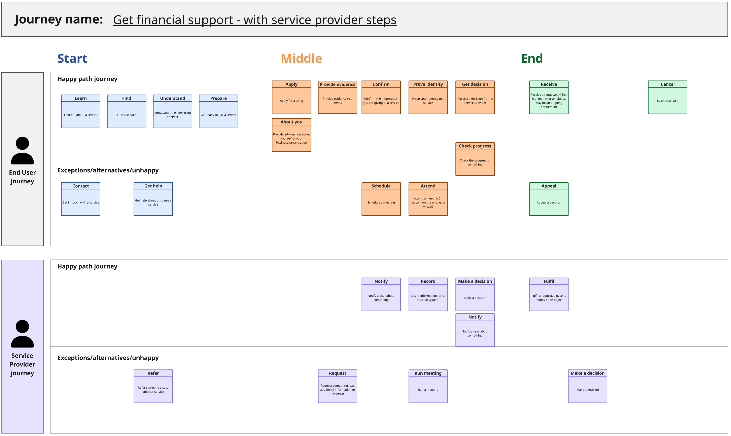
Service Provider journey example
Notes:
Squares are service patterns
Presented in a menu you can choose from
Categorised where they might appear in the journey

Slide 25
Icebreaker
Goal:
Get yourself familiar with some of the basic features of MIRO, before we start the bigger exercises.
Exercise time: 3 minutes
Instructions:
Individually, copy and paste one of the post-it notes in the frame on the right
In your copied post-it note, add a word or statement that describes a great service experience
Add a smaller post-it note underneath with your name and organisation
If you're feeling creative, change the colour of the post-it note, or you can even add emojis or gifs

Slide 26
Exercise 1: Create an End User journey
Goal:
With the other people in your breakout group, capture an example 'End user' service journey using the patterns from the Service Patterns Menu.
Exercise time: 15 minutes
Instructions:
Find an 'animal themed' section on the MIRO board for your breakout group to use for the exercises
Select an example service journey from the 3 options to use as your service journey example. We've included links to the GOV.UK pages that support these services to help you map out the journey.
Add the name of your selected service to the grey box at the top of the 'Exercise 1' frame.
Start creating the service journey for your selected service in the 'End User journey' frame. You'll do this by copying and pasting the service patterns into one of the two swim lanes: Happy path or Exceptions / alternatives / unhappy
As much as possible, try to use the pre-existing service patterns from the menu to build your journeys. Only add new ones if you feel it's absolutely necessary!!!
Don't forget this is just for practice to get you familiar with using the service patterns menu, it doesn't have to be perfect!

Slide 27
Exercise 2: Create a Service Provider journey
Goal:
With the other people in your breakout room, capture an example 'Service Provider' journey using the patterns from the Service Patterns Menu. You'll be basing this on the same service as exercise 1.
Exercise time: 10 minutes
Instructions:
Start creating the journey in the 'Service Provider journey' frame, by copying and pasting the service patterns into one of two swimlanes:
    Happy path: What are the common patterns that would happen for a service provider if everything went to plan?
    Exceptions / alternatives / unhappy: What are the patterns that might appear for a service provider less commonly in the service journey?
Your journey for Service Providers should primarily be made up of the purple patterns, but you may also need to use the other patterns from the service patterns menu.

Slide 28
Reflections

Slide 29
Summary
You can:
Describe what service patterns are, and their uses
Create user journeys using service patterns
Think about what to do next with service patterns

Slide 30
Resources

Slide 31
Service patterns menu
https://miro.com/app/board/uXjVG2fEdMQ=/?share_link_id=575024582228
password = sdingov2026

Slide 32
Community
Mailing list:
https://subscribepage.io/servicepatternsuk
Resources:
https://resources.servicepatterns.uk/

Slide 33
Join our next community call
Online
Thursday 26th March 12:00– 13:00
Register here

Slide 34
Q&A

Slide 35
Thanks!
Copy of the service patterns menu (password = sdingov2026 ):
https://miro.com/app/board/uXjVG2fEdMQ=/?share_link_id=575024582228
Resources:
https://resources.servicepatterns.uk/
Mailing list:
https://subscribepage.io/servicepatternsuk
Next community call:
https://events.teams.microsoft.com/event/cf6c2896-f9a5-43b8-8f05-7551991c6fd7@c6874728-71e6-41fe-a9e1-2e8c36776ad8

