Slide 1
Time for young people
Making Time- A case study and workshop exploring how relationships and imagination can support design leadership now and in the future
Notes:
Introduce ourselves and our roles at the outset

Slide 2

Settling in and taking care
Our case study is around 10 minutes long plus 5 minutes for Q&A
We’ll then have a collaborative activity and reflections for the last 45 minutes
Feel free to add questions to the chat, and the Slack channel if you think of any later!
Ask us to talk louder if you can’t hear us, or if you need anything else from us
We encourage camera’s on, but turn the off if you need, fidget and doodle!
Stretch your legs and move about, generally do what you need to be comfortable
Notes:
India: 30 seconds

Slide 3
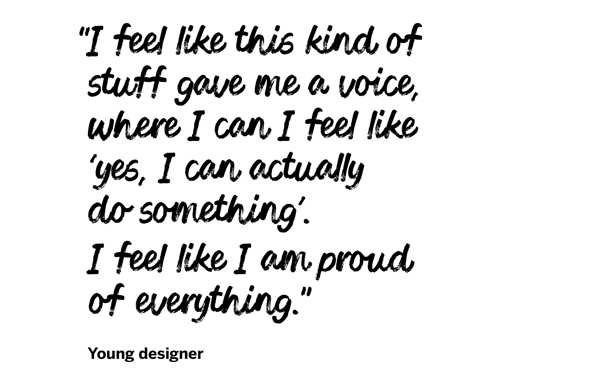
We hope your main takeaways from our talk will be:
An example and some enabling conditions for design leadership within a third sector organisation
Increased understanding of how to navigate multi-disciplinary strategic projects and uneven power dynamics
Practical methods for building trust and understanding with a range of collaborators
Using play and imagination to think together about future collaborators in design
Notes:
India: 1 minute
Overview of takeaways (not reading verbatim)
Context of it being a big project, so we’ll focus on one specific example

Slide 4
Case Study

Slide 5




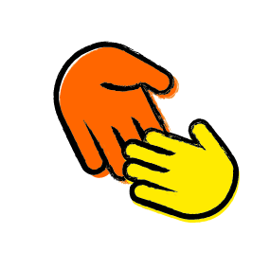
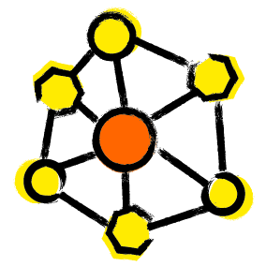


Project aims
To develop an easy access, early intervention wellbeing service
Initially in Newham, East London, with the ability to scale
To support reversing the decline in young people’s wellbeing
To inform fundraising, Policy, Advocacy and Influencing
Role of Design
To co-create with young people, drawing on evidence and best practice
To define how the service would run to positively impact young people and systems
To establish ongoing testing, learning and service evolution
Supporting the core project aims, alongside internal teams and external partners

Slide 6
People Involved (stakeholder map)
2022
2024
Initial discovery
Defining
Implementation
Service Design Team
Young Designer’s Group
Youth Voice and Participation
Policy & Research Teams
Buildings & Procurement
Service Teams and Area Managers
Local Council and other community partners
Business Development & Finance
Creative – Graphics and Interior
Storytelling - Communication and Video Creation
Project Steering Group, Sponsors & Project Management
Project set-up
Discovery
Developing
Notes:
Many people involved
Different capacities: guiding, supporting, progressing their own focus
Last ones were the key people to drive the design work forwards
2 year long project involved a lot of teams which resulted in rescoping the traditional Service Design process that I had in my head
And to amplify India’s point: maybe we did plan more than we could hold solo as a service design team
Set-up teams
Supporting Teams
Key teams

Slide 7
Challenges
Design awareness: Many colleagues were confused about the role and methods of Service Design
Time: Having long enough to build trust and relationships internally and externally
Competing priorities: Multi-faceted project with many needs
Power: Knowing what power we had and what we could share with our young people and colleague co-design groups
Notes:
Prioritising building relationships at the start more than the delivery
We thought we would deliver ourselves with light touch advice, but ended up being very collaborative with the teams mentioned
Give examples of constraints: how much power we could share, limits on what they could do on their own, not enough time for full training
Support needed to hold the group
Being a Service Designer vs being a Service Designer and a Youth Practitioner
Relying more on the expertise that was inhouse – Job recruitment
Be specific on who was in the team and who needed, for what: safeguarding, facilitation, holding the group etc. again focus on YP group more. Give examples of constraints: how much power we could share, limits on what they could do on their own, not enough time for full training

Slide 8





Forging strong relationships: Delivery teams
Challenge: Design awareness
Increased understanding and buy in
Information session: what & why of Service Design
Co-led community engagement & testing
RESULT
ACTION
RESULT
ACTION
Iterated concepts based on feasibility & viability
Took a step back, considered collaborators needs
ACTION
Developed service activities & journeys
Ongoing collaboration in service development & improvement
RESULT
Planned closer collaboration to design together
Notes:
It was really important for us that we worked closely with the service delivery team, as they were making some delivery decisions alongside our design work. We also knew it was important that they fed into design decisions to ensure they were evidence based
Workstream sponsor raised concerns shared by Head of YP services Southern England & Area Manager for London
Different mindsets: design vs mobilization. Need for speed! i.e. with the selection of the building, drawing on existing networks
Sharing logic, creating space for research and intention, building new local connections, being aware of power
Bridging difference
Understanding what each person brings, what else we need
Importance of not just focusing on the end user but also the delivery team
Really great opportunity to work this closely together for this project and for embedding in-house service design

Slide 9
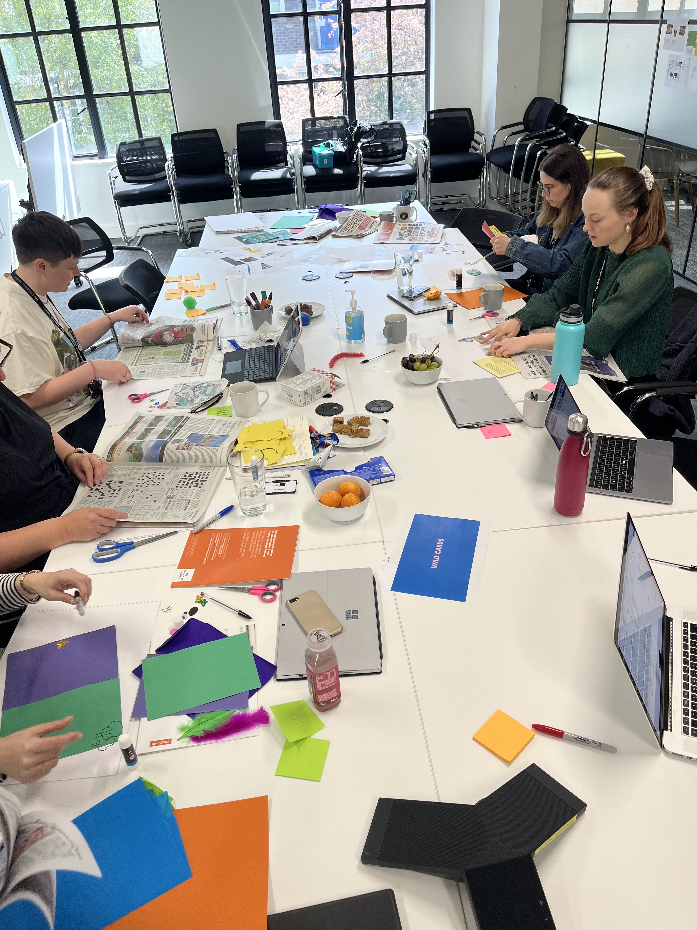
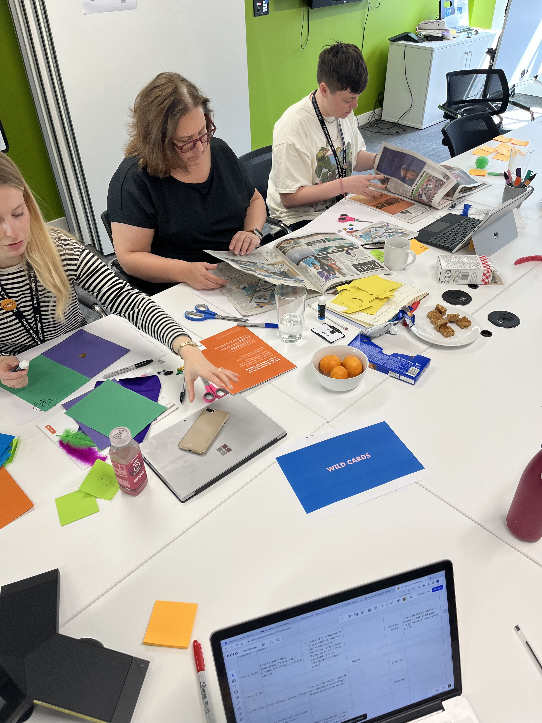
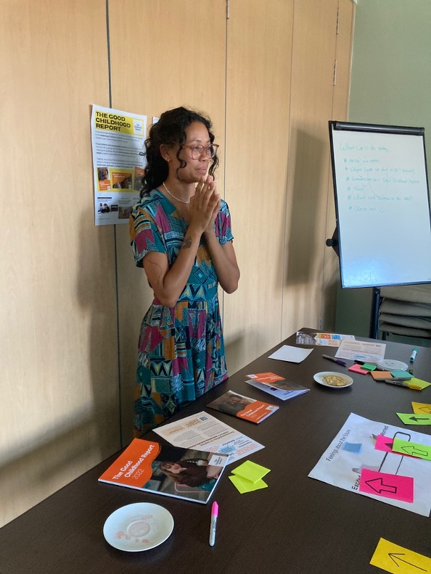

Slide 10




Bridging practices through…
Utilising…
Slowing down & stepping back
Knowledge sharing, contextualising design & delivery, pragmatism
Service design activities that drew on practitioner expertise and community knowledge
Identifying shared goals, assets & collaboration
Feedback & joint decision making
Testing and prioritising service elements together
Aligning values
Returning to the project purpose
and impact

Slide 11





Addressing power dynamics: With young people
Built in rounds of testing and iteration with young people and stakeholders
Challenge: Where can power be shared?!
Young people couldn’t have the final decision on areas such as brand, furniture, activities
ACTION
Communicated with young people regularly on how their views would be used
RESULT
Decision making needed to go through many teams
ACTION
ACTION
Young people had a meaningful input, strategic and financial needs met
Consulted further with stakeholders on constraints and decision making
Notes:
Big project, multiple needs and people- reference stakeholders
Wanted to deliver a fully co-designed process
Assumed more power to share decision making then we had
Learning journey for all of us: different mindsets and expectations
First time we’d attempted co-design at this scale

Slide 12
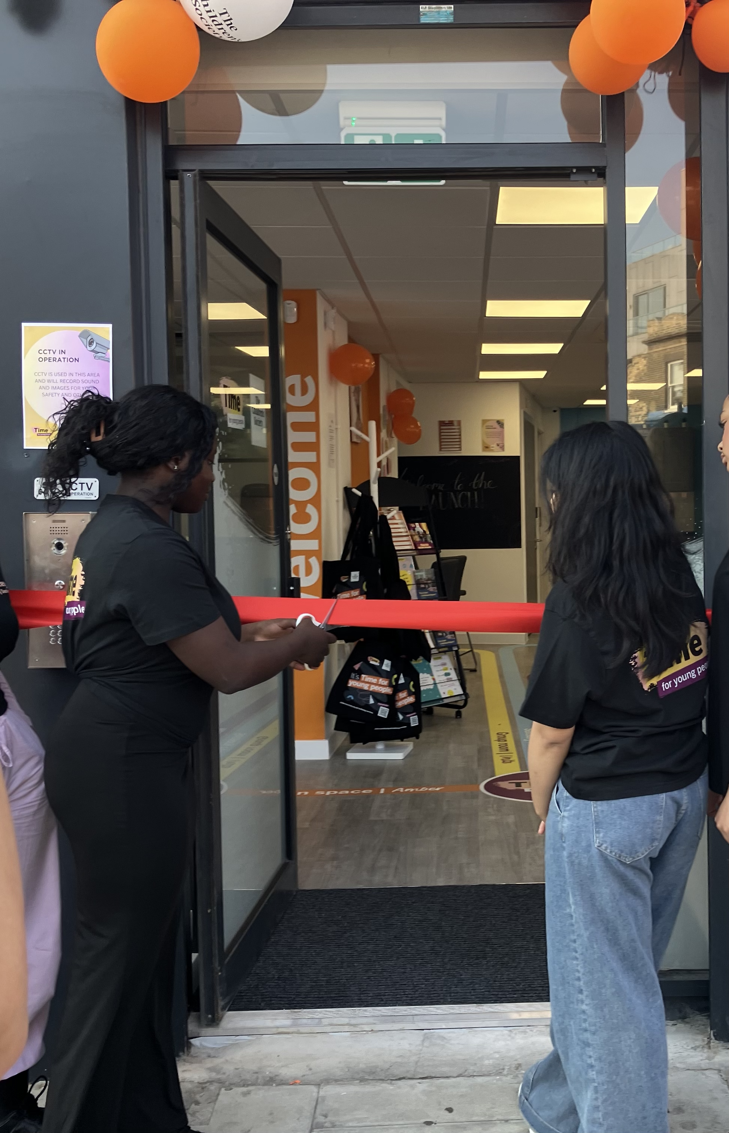
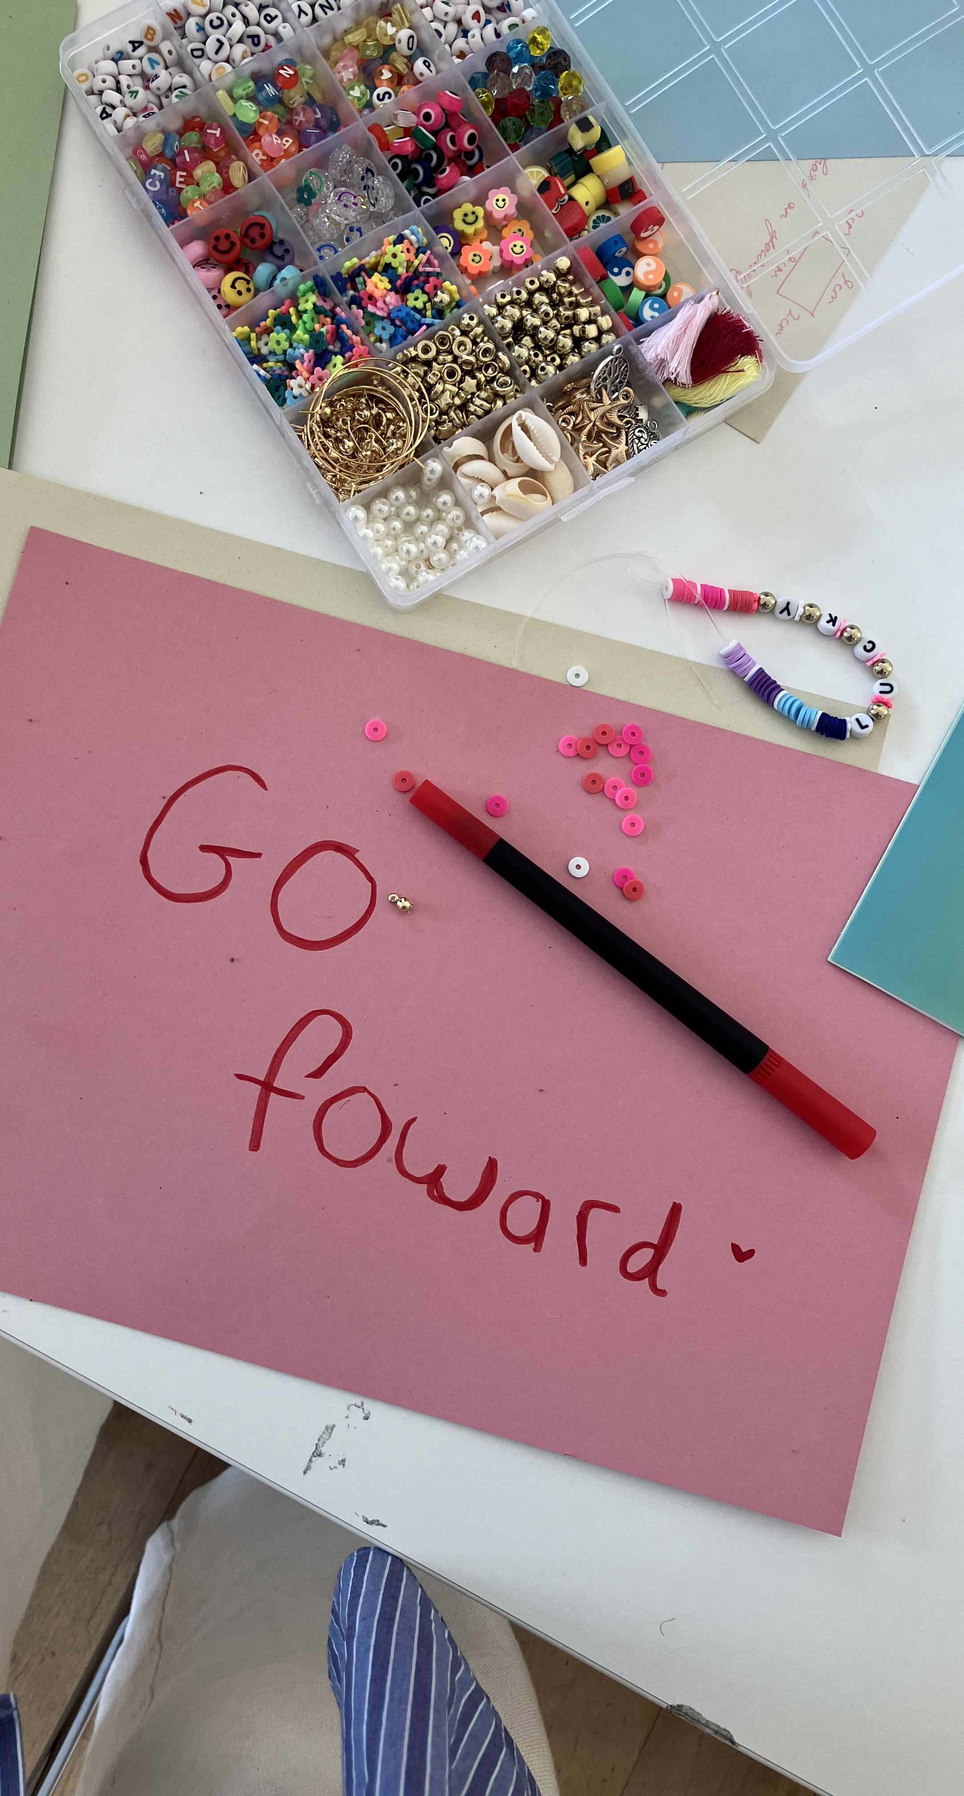
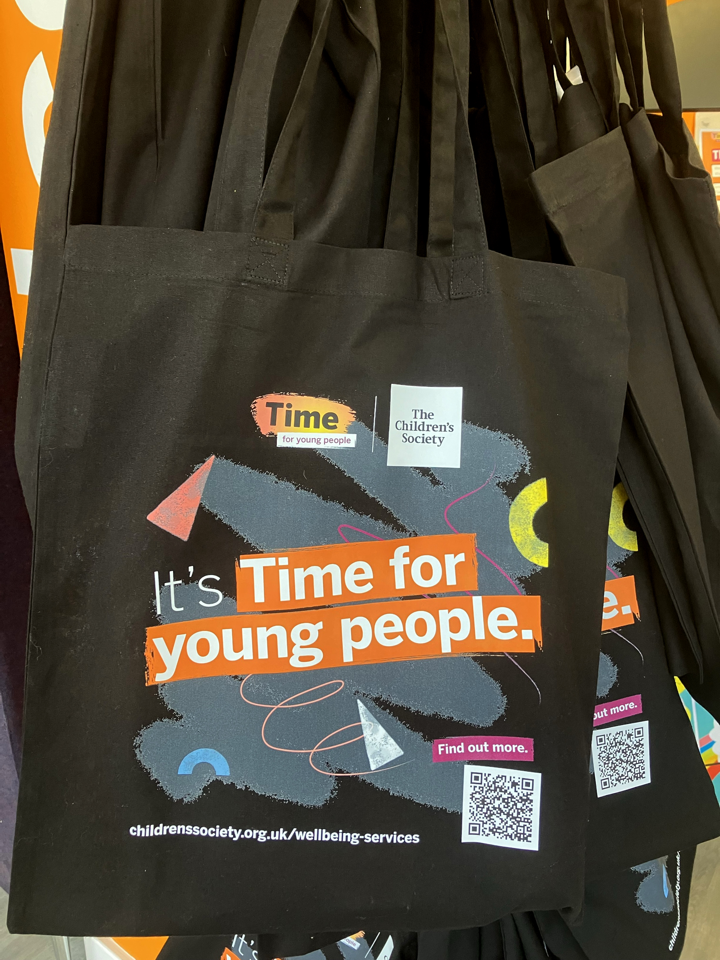

Slide 13

Enablers for constructive collaboration in Design
Mindsets and qualities
Imagination
Resilience
Understanding
Curiosity
Cultural competence
Ability to sit with uncertainty
Values and approaches
Motivated to make change for young people
Reflective
Honest
Collaborative
Caring
Brings challenge
Skills and practices
Clear power assessment
Pre-established roles, constraints and decision making processes
Contribution of unique skills, expertise and networks
Notes:
What we found really helped to drive collaboration forwards from both colleagues and YP as well as some practices we’d introduce were we to do it again

Slide 14
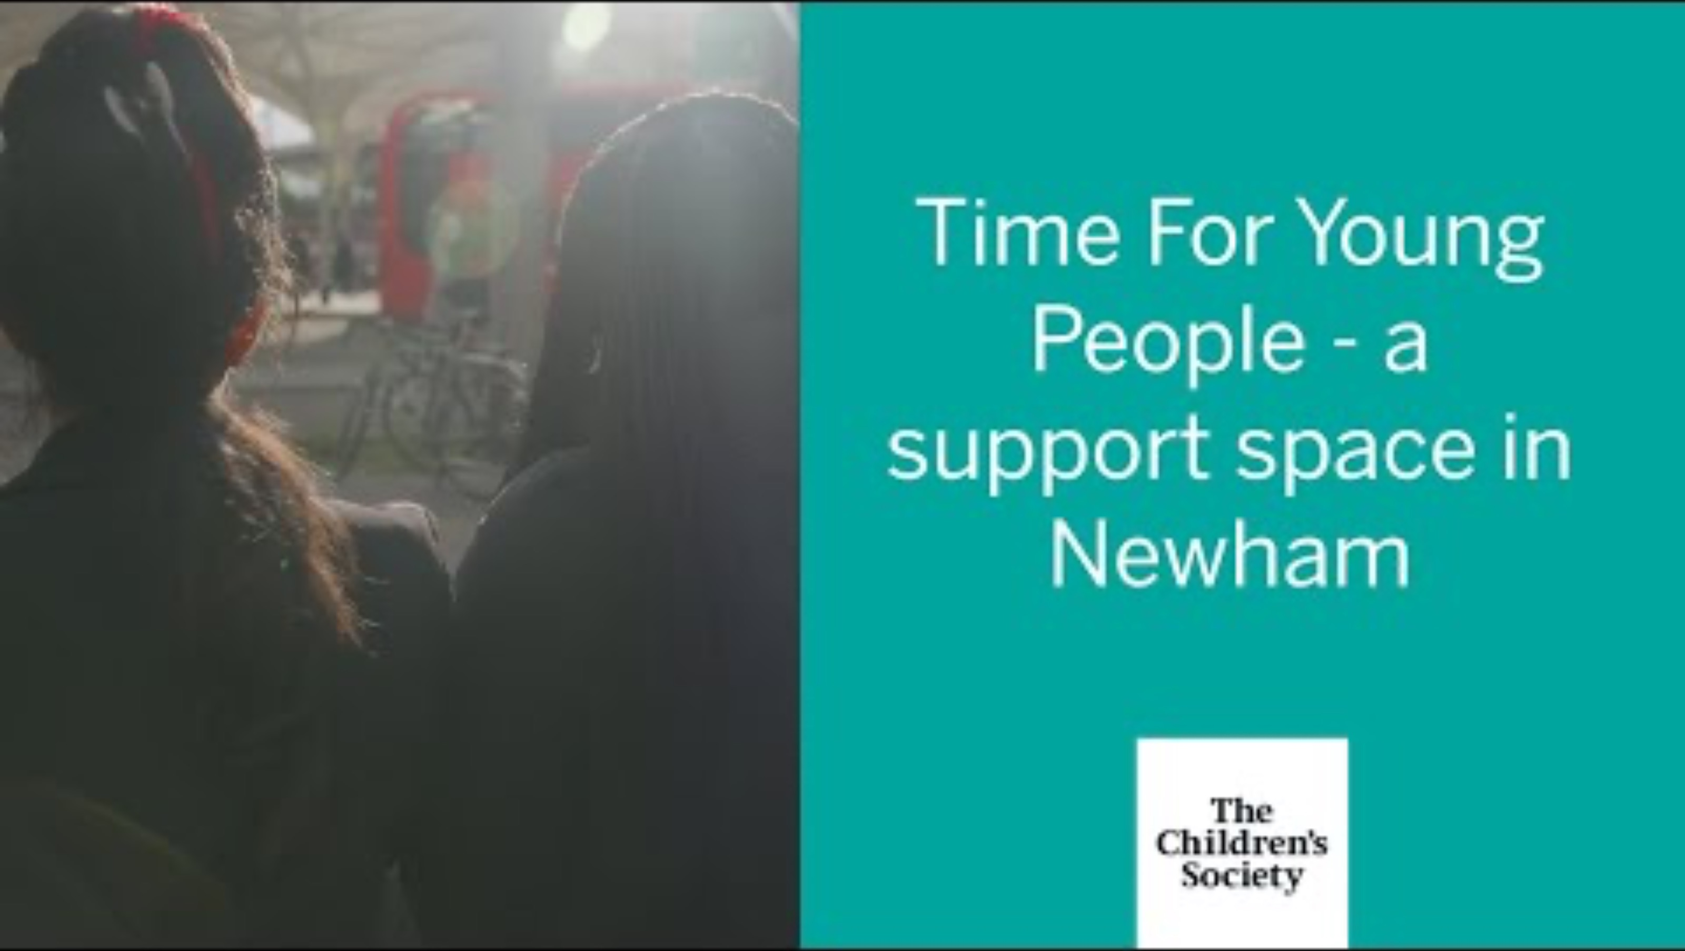
VIDEO

Slide 15
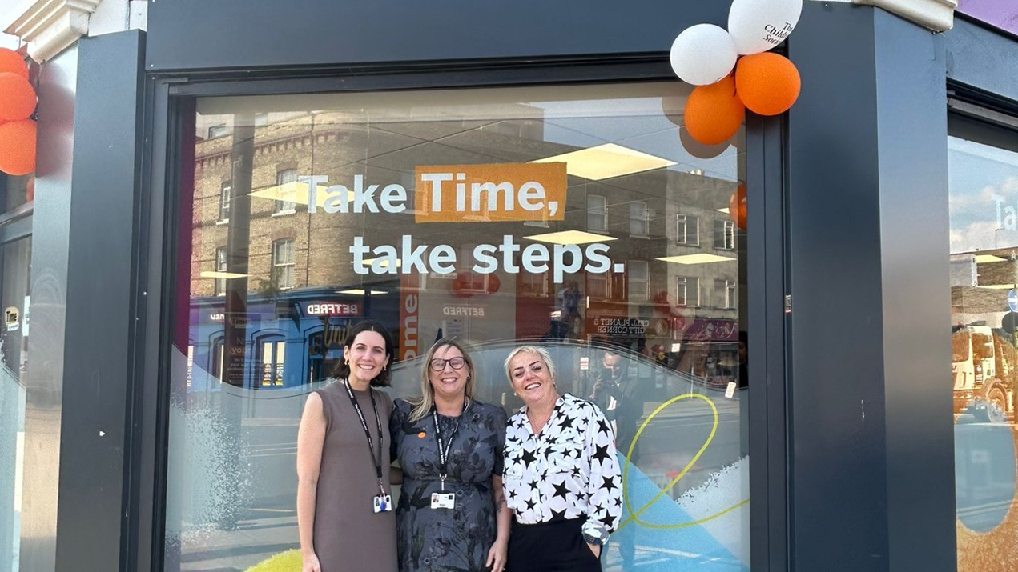

Slide 16
Thank you!
If you’d like to chat more or would be interested in doing a ‘lunch & learn’ with our team, get in touch!
india.roche@childrenssociety.org.uk
jessicaann.veno@childrenssociety.org.uk
Notes:
India: thanks everyone, close the session.

